Slide 1


Food Cycle
إعادة تدوير الطعام
OOP Project year: 2026

Slide 2
Professors:
Team Members:
ملك شريف المتولي
ملك عبدالعظيم أبو المجد
هاجر إبراهيم محمد
معاذ هشام داود
مصطفى علاء الدين سعد
مصطفى اسعد دوابه
أ.د/ محمد أبو السعود
أ.م. د/ سارة المتولي
د/ محمد حجاج
د/ محمد حندوسه
د/ وليد العدروسى
Instructor:
م/ سيف هشام

Slide 3
Project Description:
Problem :​
Huge food waste in restaurants/hotels vs. charities in need.​
Solution:
C# Windows Forms app connecting providers and charities via an Admin safety gate.
Key Features:​
OOP Structure: Multi-user system (Admin, Provider, Charity).
Safety Check: Admin validation for all donations.
File Storage: Saving data in files for persistence.

Slide 4
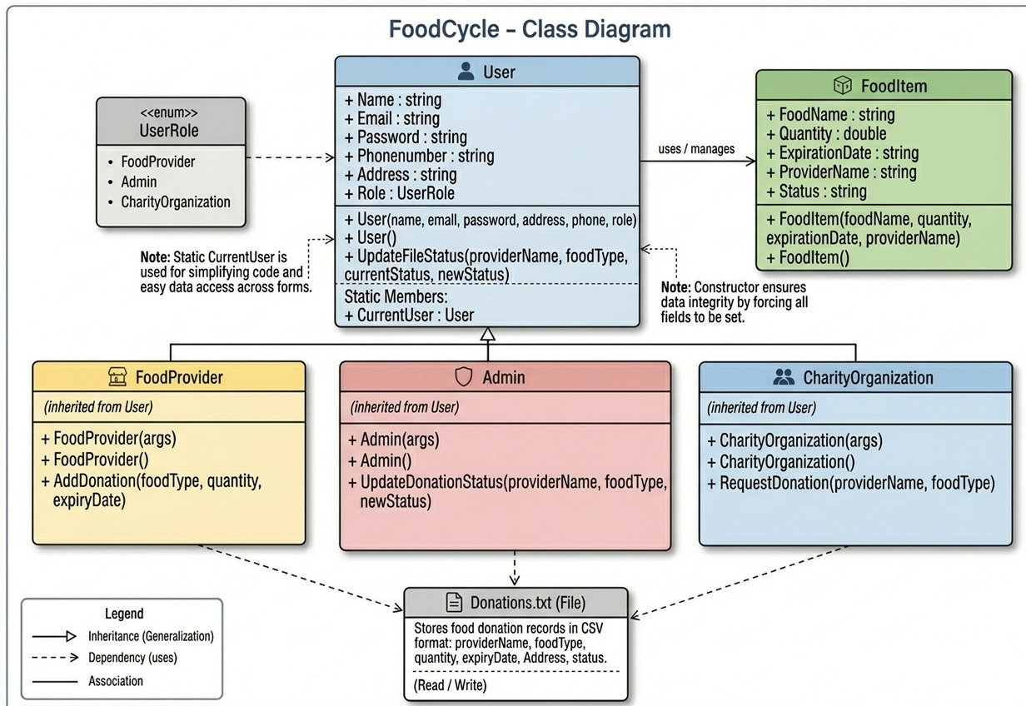
Class Diagram:
This diagram illustrates the object-oriented structure of the FoodCycle system:
Inheritance: The base class User contains shared attributes. The classes FoodProvider, Admin, and CharityOrganization inherit from User, acquiring its properties while implementing their own specific roles.
Dependency: The derived classes depend on the Donations.txt file for data persistence. They read from and write to this file to manage donation lifecycles.
Association with FoodItem: The system manages FoodItem objects, which track the donation's details and current status (e.g., Pending, Accepted,Requested).

Slide 5
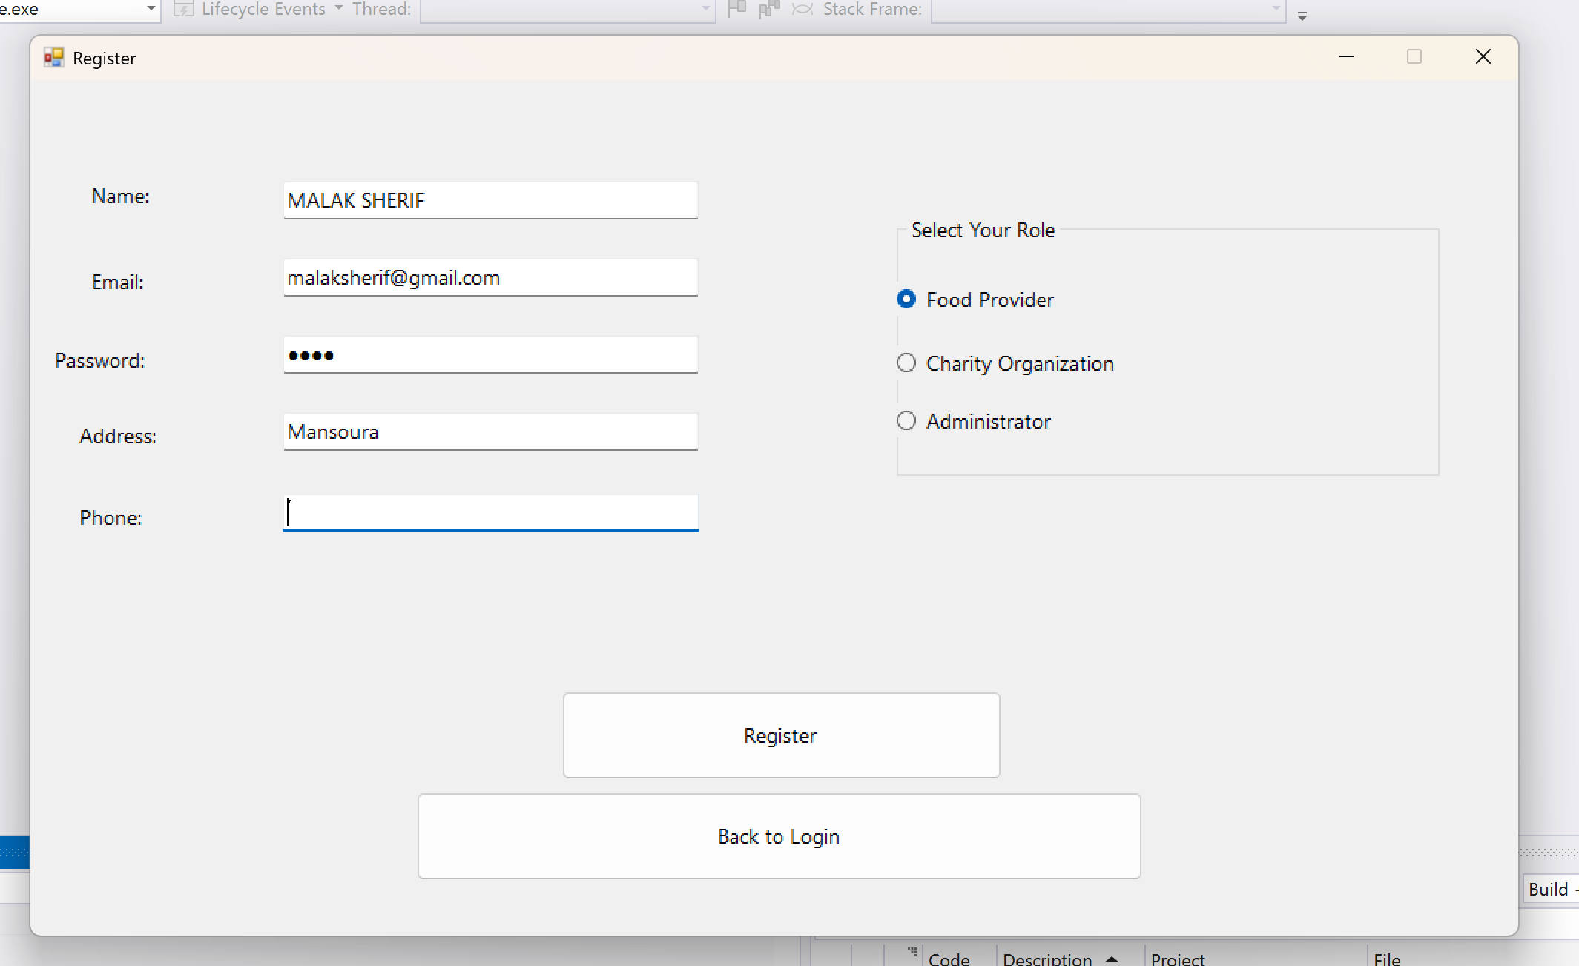
Screenshot 1:
1. Register Screen: Enables new users to create accounts and select their specific roles to streamline donation management.

Slide 6
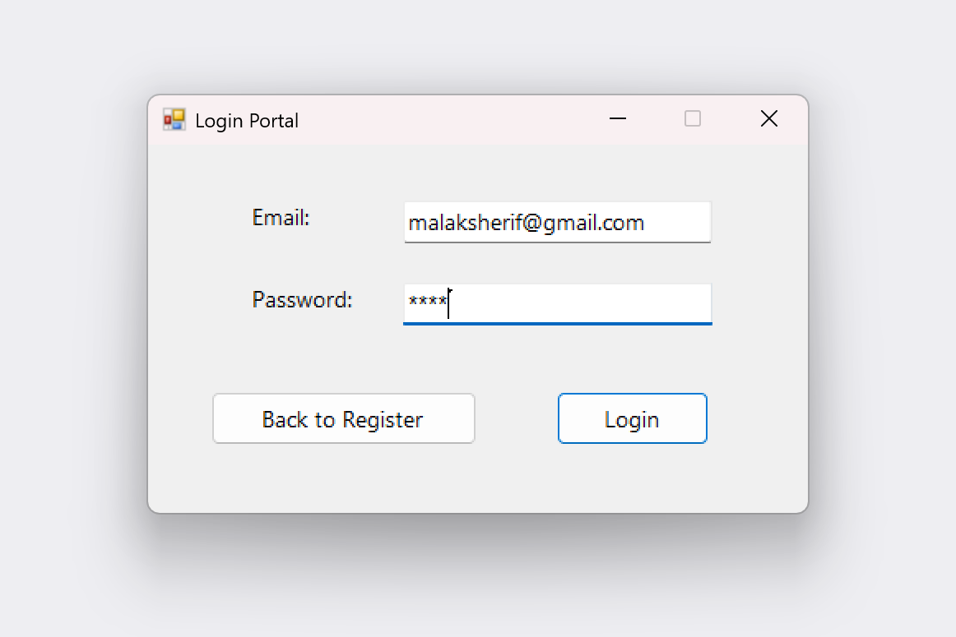
Screenshot 2:
2. Login Portal: A secure authentication interface that validates user credentials to grant access to the system based on the assigned user role.

Slide 7
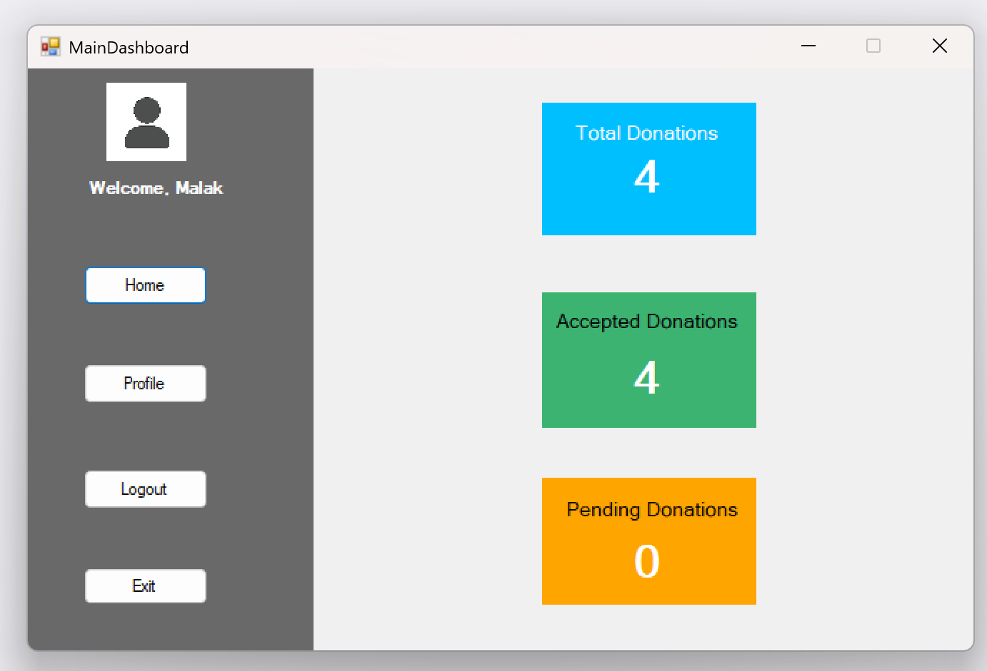
Screenshot 3:
3. Main Dashboard: A visual control panel providing donors and charities with real-time statistics on total, accepted, and pending donations.

Slide 8
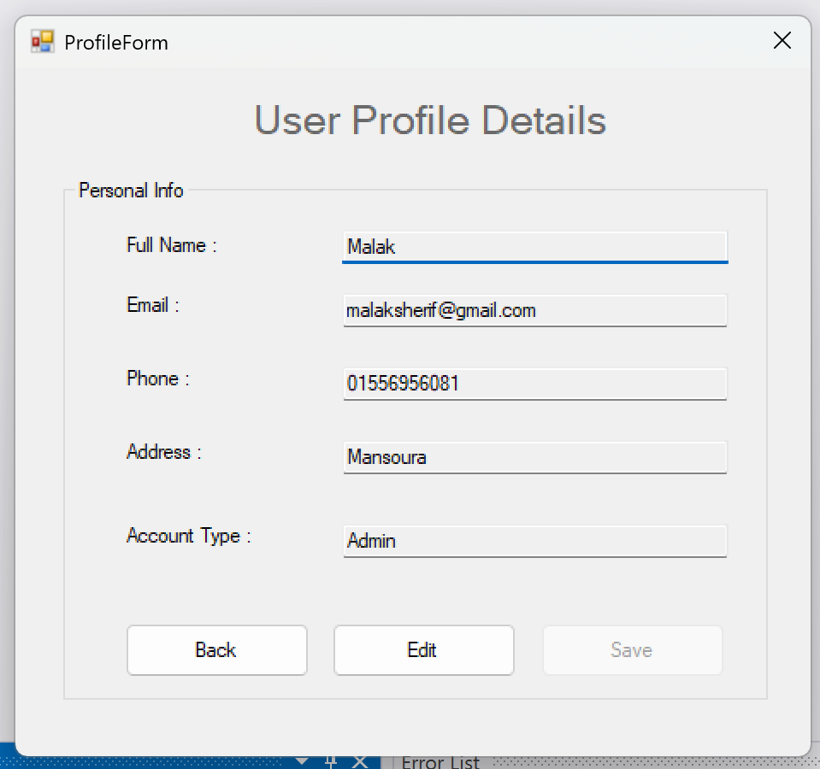
Screenshot 4:
4. Profile Form: Displays the user's personal information (name, phone, address, and account type) and allows for editing.

Slide 9
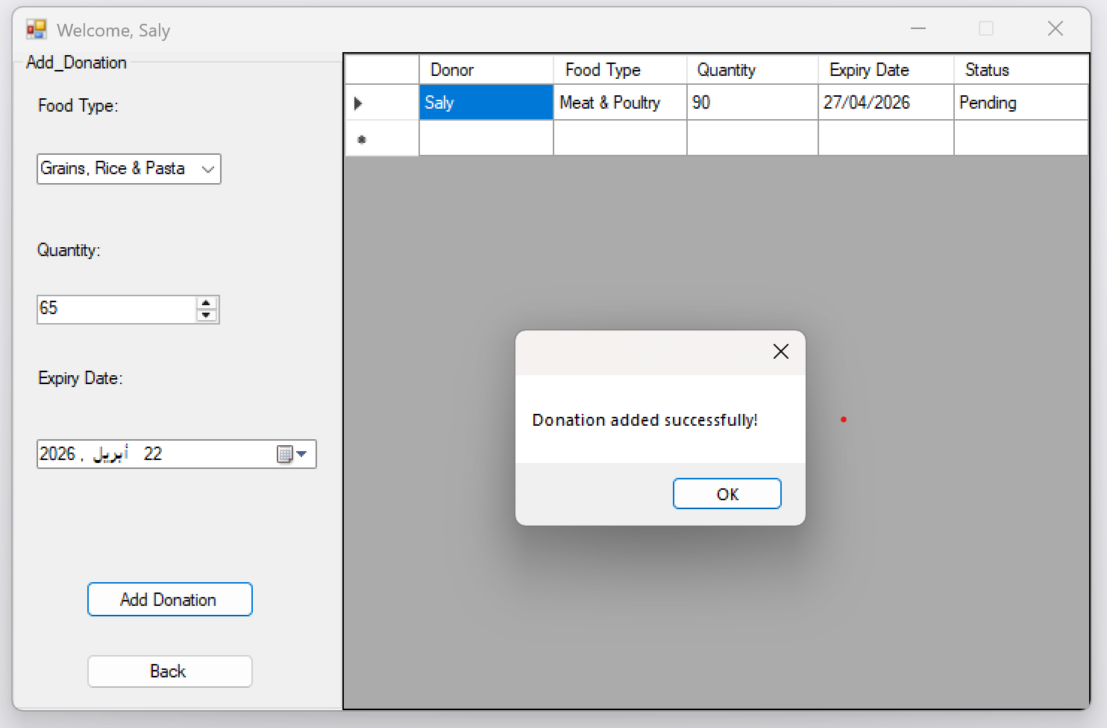
Screenshot 5:
5. Donation screan: This interface allows food providers to easily submit their food donations by specifying the food type, quantity, and expiry date.

Slide 10
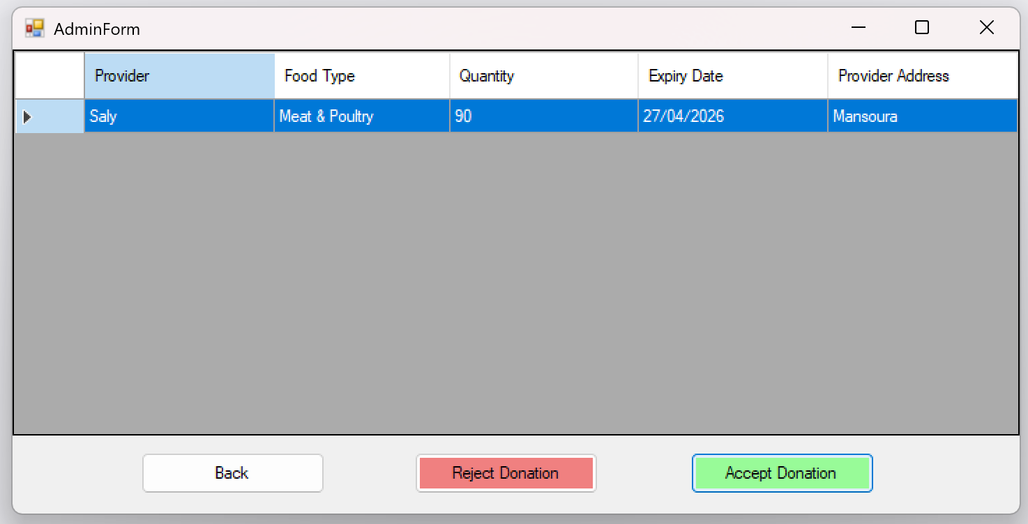
Screenshot 6:
6. Admin Form: An interface for approving or rejecting donations, which updates the status in the system immediately.

Slide 11
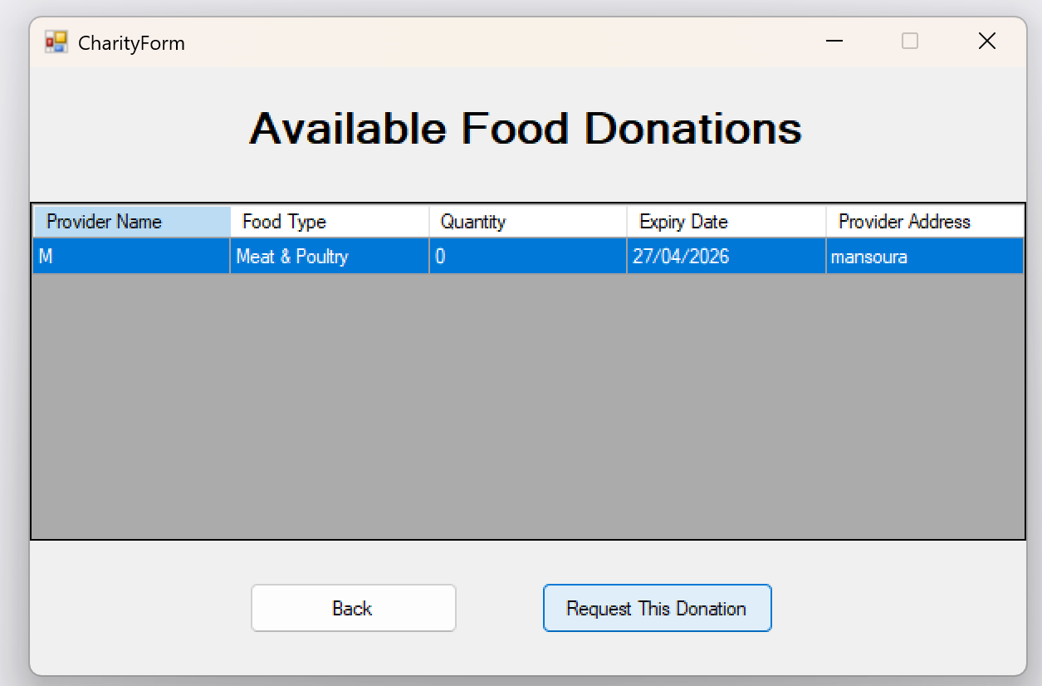
Screenshot 7:
7. Charity Form: This screen displays a list of food donations approved by the administrator, allowing charity organizations to view details and request specific donations.

Slide 12
THANK YOU FOR YOUR ATTENTION

